Slide 1
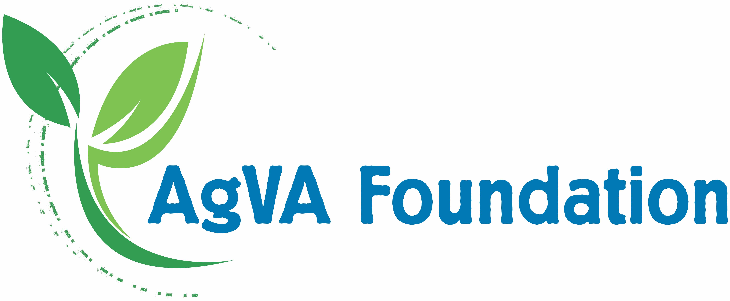
Better Business
5 types of Business Ownership

Slide 2
5 Types of Business Ownership
Sole Proprietorship
Partnership
Limited Liability Company (LLC)
Corporations
Cooperative

Slide 3
Sole Proprietorship
A non-registered business without a separate business entity.
No Separation between the business owner’s personal and professional assets and liabilities.
One of the most common types of business ownership.
Good option for starting a low-risk business on a trial business.
Benefits:
Simple & easy to start
No additional federal or state taxes
Drawbacks:
Owner assumes all risk
Personally liable for all financial obligations
Personally liable for all legal obligations
Notes:
A sole proprietorship occurs when someone does business activities but doesn’t register as another kind of business. There is no separate business entity, meaning there is no distinction between the business owner’s personal and professional assets and liabilities.
Sole proprietorships are simple, easy to start, and one of the most common types of business ownership. They are a good option for someone starting a low-risk business on a trial basis. Also, no additional taxation.
However, because there is no formal separation, the business owner will become personally liable for any obligation the business might have.

Slide 4
Partnership
Simplest type of business when two or more people are involved.
A non-registered business without a separate business entity.
No Separation between the business owner’s personal and professional assets and liabilities.
Good option for starting a low-risk business on a trial business.
Benefits:
Simple & easy to start
No additional federal or state taxes
Financial risk is are shared with partners
Shared management
Utilize varied skills of the partners
Drawbacks:
Owners assumes all risk
Personally liable for all financial obligations
Personally liable for all legal obligations
Notes:
Similar to sole proprietorships, a partnership is the simplest type of business ownership when two or more people are involved.

Slide 5
Limited Liability Company (LLC)
Registered business with a separate business entity
Separates the owner’s personal and professional assets
good choice for a business owner willing to take a little bit of a bigger risk or one looking to protect their personal assets.
Benefits:
Protects the owner’s personal assets from legal and financial risk
LLCs do not pay additional federal income taxes associated with being a corporation.
Drawbacks:
Pay taxes associated with self-employment
Might be subject to state taxes, depending on location
Notes:
Limited Liability Company (LLC). A limited liability company (LLC) separates the owner’s personal and professional assets. Meaning if your business gets hit with a lawsuit or goes bankrupt, your house, car, and personal piggy bank are safe.
Similar to sole proprietorships and partnerships, LLCs do not pay additional federal income taxes or those associated with being a corporation. However, depending on their location, they might be subject to other state taxes. Also, LLCs fall under the category of self-employment, so those taxes fall on them as well.
An LLC is a good choice for a business owner willing to take a little bit of a bigger risk or one looking to protect their personal assets.

Slide 6
Corporation
Registered business with a separate business entity
Offers the most protection from personal liability
Corporations can be funded my multiple investors by purchasing stock.
A stock is a partial share in a company.
When people buy stock, they buy ownership and decision-making responsibilities
Start-up costs involved.
Legally required to keep more records and release reports
Owners pay income taxes
Good structure for a business owner looking for a little more risk, good funding options, and the prospect of eventually “going public,” (ie: selling stock to the public)
Notes:
Corporations: A corporation is its own entity kept separate from its owners. This means they offer the most protection in terms of personal liability.
Corporations have an advantage when it comes to funding: stock. A stock is a partial share in a company, so when people buy stock, they are essentially buying ownership and decision-making responsibilities.
However, starting a corporation costs more than any other business structure. Not only are they legally required to do keep more records and release more reports, but they also pay income tax. In some cases, there is even double taxation - once on profits, and then again on the dividends distributed to stockholders.
With so many different stakeholders contributing to the same business, corporations become solid. If someone leaves, the business remains relatively unaffected.
A corporation is a good structure for a business owner looking for a little more risk, good funding options, and the prospect of eventually “going public,” which means the company will eventually sell stock to the public.

Slide 7
Corporation (continued)
Benefits:
Provides the most protection for owner’s personal assets
Many people involved – Shared risk & decision making
Diversified funding
Drawbacks:
Subject to more taxes
Double taxation in some cases (once on profits, once on dividends distributed to stockholders)
Might be subject to state taxes, depending on location
Expensive & more complicated to start
More records to keep

Slide 8
Cooperative
Private business owned and operated by the people who use its products and services.
Main purpose is to provide goods and services for its members
Elected board
Members buy shares or pay a membership fee to be part of decision-making process and share in the profits.
Profits distributed to members (dividend payments)
Co-ops are common in agriculture, energy, and finance (credit unions)
Agriculture co-ops
Help farmer-members market and process their crops and livestock.
Some process and market food products (Land O’Lakes butter)
Provide needed supplies (fertilizer, seed, etc.)
Provide services (agronomy consultation, technology services, etc.)
Notes:
Cooperative. A cooperative is a private business owned and operated by the same people that use its products and or services. The main purpose of a cooperative is to fulfill the needs of the people running it. The profits are distributed among cooperatives member-owners. There is typically an elected board that runs the cooperative, and members can buy shares to be apart of decision-making processes.
There are many types of cooperatives, from housing, energy, and food purchasing co-ops, to agricultural co-ops.
Agricultural co-ops help farmer-members market and process their crops and livestock. This means that they help market or sell the grain to an end user like Quaker Oats, General Mills, or any other company that might use it for human food, livestock feed, or an industrial purpose. Co-ops also help farmers secure needed supplies and services. This might mean that they run a store that carries things like fertilizer, pesticides, seeds, or other needed supplies. Some co-ops only provide products and services to farmers like agronomy consultation, technology services, or other services that will benefit the farm. Other co-ops (like Land O’Lakes for example) process and market food brands (like butter) we find at grocery stores.
Earnings of the cooperative business are returned to the farmer-members as dividend payments. The payment that each member receives is based on how much they used the co-op’s services (i.e.: amount of product purchased or sold through the co-op).

Slide 9
Cooperative (Continued)
Benefits:
Reliable access to needed supplies and services
Better prices & a reliable market for farm products
Shared risk
Shared profit
Members have a say in major business decisions
Drawbacks:
Shared profit
Shared decision making

